Slide 1
A Blocked Approach for Implementing the Floyd-Warshall Algorithm in CUDA
CS5395: Independent Study Project
Shubhangi Mahajan; Advisor: Dr. Martin Burtscher

Slide 2
Independent Study Objective
The purpose of this independent study is to optimize the Floyd-Warshall APSP Algorithm on a GPU using CUDA for a scalable implementation.

Slide 3
Overview
Floyd-Warshall Algorithm
Graph Representation
Optimization Approaches
Results
Related Work
Conclusion

Slide 4
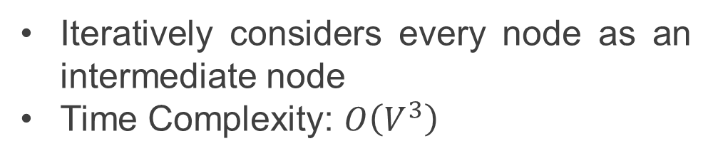
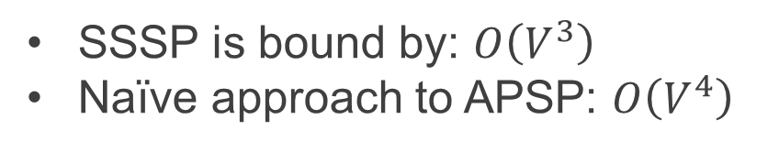
Floyd-Warshall Algorithm
All Pairs Shortest Path (APSP) Problem
0
SSSP is bound by: $O\left(V^{3}\right)$
Naïve approach to APSP: $O\left(V^{4}\right)$
4
-2
3
1
2
-1
2
Iteratively considers every node as an intermediate node
Time Complexity: $O\left(V^{3}\right)$
3
 | 0 | 1 | 2 | 3
0 | 0 | -1 | -2 | 0
1 | 4 | 0 | 2 | 4
2 | 5 | ∞ | 0 | 2
3 | 3 | -1 | 1 | 0
 | 0 | 1 | 2 | 3
0 | 0 | -1 | -2 | 0
1 | 4 | 0 | 2 | 4
2 | 5 | 1 | 0 | 2
3 | 3 | -1 | 1 | 0
 | 0 | 1 | 2 | 3
0 | 0 | ∞ | -2 | 0
1 | 4 | 0 | 2 | ∞
2 | ∞ | ∞ | 0 | 2
3 | 3 | -1 | 1 | 0
 | 0 | 1 | 2 | 3
0 | 0 | -1 | -2 | 0
1 | 4 | 0 | 2 | 4
2 | ∞ | ∞ | 0 | 2
3 | 3 | -1 | 1 | 0
 | 0 | 1 | 2 | 3
0 | 0 | ∞ | -2 | 0
1 | 4 | 0 | 2 | 4
2 | ∞ | ∞ | 0 | 2
3 | 3 | -1 | 1 | 0
 | 0 | 1 | 2 | 3
0 | 0 | ∞ | -2 | ∞
1 | 4 | 0 | 2 | ∞
2 | ∞ | ∞ | 0 | 2
3 | 3 | -1 | 1 | 0
 | 0 | 1 | 2 | 3
0 | 0 | ∞ | -2 | ∞
1 | 4 | 0 | 2 | ∞
2 | ∞ | ∞ | 0 | 2
3 | 3 | -1 | ∞ | 0
 | 0 | 1 | 2 | 3
0 | 0 | ∞ | -2 | ∞
1 | 4 | 0 | 2 | ∞
2 | ∞ | ∞ | 0 | 2
3 | ∞ | -1 | ∞ | 0
 | 0 | 1 | 2 | 3
0 | 0 | ∞ | -2 | ∞
1 | 4 | 0 | 3 | ∞
2 | ∞ | ∞ | 0 | 2
3 | ∞ | -1 | ∞ | 0
Takes approximately 1000 seconds for a graph with 10000 vertices

Slide 5
How to Parallelize FW?
Pseudo-code
k = 3
for k from 1 to |V|
for i from 1 to |V|
for j from 1 to |V|
if AdjMat[i][j] > AdjMat[i][k] + AdjMat[k][j]
AdjMat[i][j] ← AdjMat[i][k] + AdjMat[k][j]
end if
 | 0 | 1 | 2 | 3
0 | 0 | -1 | -2 | 0
1 | 4 | 0 | 2 | 4
2 | 5 | ∞ | 0 | 2
3 | 3 | -1 | 1 | 0
 | 0 | 1 | 2 | 3
0 | 0 | -1 | -2 | 0
1 | 4 | 0 | 2 | 4
2 | 5 | 1 | 0 | 2
3 | 3 | -1 | 1 | 0
 | 0 | 1 | 2 | 3
0 | 0 | -1 | -2 | 0
1 | 4 | 0 | 2 | 4
2 | ∞ | ∞ | 0 | 2
3 | 3 | -1 | 1 | 0

Slide 6
Graph Representation
0 | 1 | 2 | 3 | 4
0 | 1 | 3 | 4 | 5
0
nindex
4
-2
0 | 1 | 2 | 3 | 4
2 | 0 | 2 | 3 | 1
Input graphs are stored in CSR format
3
1
2
nlist
-1
2
0 | 1 | 2 | 3 | 4
-2 | 4 | 3 | 2 | -1
3
eweight
 | 0 | 1 | 2 | 3
0 | 0 | ∞ | -2 | ∞
1 | 4 | 0 | 3 | ∞
2 | ∞ | ∞ | 0 | 2
3 | ∞ | -1 | ∞ | 0
 | 0 | 1 | 2 | 3
0 | 0 | -1 | -2 | 0
1 | 4 | 0 | 2 | 4
2 | 5 | 1 | 0 | 2
3 | 3 | -1 | 1 | 0
CSR graph is converted to Adjacency Matrix before implementing FW
FW
Adjacency Matrix represented as a contiguous array
0 | ∞ | -2 | ∞ | 4 | 0 | 3 | ∞ | ∞ | ∞ | 0 | 2 | ∞ | -1 | ∞ | 0
$AdjMat\left[i\right][j]$ becomes $AdjMat[i ∗V+j]$

Slide 7
Simple Parallel Implementation on GPU Using CUDA
GPU with 3 blocks and 4 threads per block
For a 5x5 graph:
Row 0 | Row 1 | Row 2
Row 3 | Row 4
Each block cyclically update a row
The threads within each block cyclically update an element in the row
Each block cyclically update a row
The threads within each block cyclically update an element in the row
Block 0 | Block 1 | Block 2
0 | 1 | 2 | 3 | 0 | 1 | 2 | 3 | 0 | 1 | 2 | 3
Threads
[0][3]
[1][3]
[2][3]
[3][3]
[4][3]
[0][2]
[1][2]
[2][2]
[3][2]
[4][2]
[3][4]
[4][4]
[1][1]
[2][4]
[0][4]
[0][1]
[1][4]
[4][1]
[2][1]
[3][0]
[0][0]
[1][0]
[3][0]
[4][0]
[2][0]
version0

Slide 8
Reducing Memory Accesses
k = 2 and i = 1
 | 0 | 1 | 2 | 3
0 | a00 | a01 | a02 | a03
1 | a10 | a11 | a12 | a13
2 | a20 | a21 | a22 | a23
3 | a30 | a31 | a32 | a33
Every element in the i-th row needs the [i][k]th element to update.
Saving the [i][k]th element at the start of the i-loop means fewer global memory accesses.
New a10 = min(a10, a12 + a20)
New a11 = min(a11, a12 + a21)
New a12 = min(a12, a12 + a22)
New a13 = min(a13, a12 + a23)
version1

Slide 9
Reducing Memory Accesses
k = 2 and j =1
 | 0 | 1 | 2 | 3
0 | a00 | a01 | a02 | a03
1 | a10 | a11 | a12 | a13
2 | a20 | a21 | a22 | a23
3 | a30 | a31 | a32 | a33
Iterating through the matrix column-wise, every element in the j-th column needs the [k][j]th element to update.
Saving the [k][j]th element at the start of the j-loop means fewer global memory accesses.
New a01 = min(a01, a02 + a21)
New a11 = min(a11, a12 + a21)
New a21 = min(a21, a22 + a21)
New a31 = min(a31, a32 + a21)
version2

Slide 10
Reducing Memory Accesses
 | 0 | 1 | 2 | 3
0 | a00 | a01 | a02 | a03
1 | a10 | a11 | a12 | a13
2 | a20 | a21 | a22 | a23
3 | a30 | a31 | a32 | a33
k = 2
at i = 1,
New a10 = min(a10, a12 + a20)
New a11 = min(a11, a12 + a21)
New a12 = min(a12, a12 + a22)
New a13 = min(a13, a12 + a23)
kth row is used to update the values for all iterations of i for a certain k.
at i = 2,
New a20 = min(a20, a22 + a20)
New a21 = min(a21, a22 + a21)
New a22 = min(a22, a22 + a22)
New a23 = min(a23, a22 + a23)
version3

Slide 11
Reducing Memory Accesses & Kernel Calls
Adjacency Matrix divided into 32x32 submatrices
Each submatrix processed for the next 32 iterations at a time
version4

Slide 12
Final Version
The submatrices in the row & the column are being updated independent of on another.
The remaining submatrices are independent of the next diagonal block.
version5

Slide 13
Methodology
CPU:
Processor | AMD Ryzen Threadripper 2950X
Cores | 16
Threads | 2
GPU:
Processor | NVIDIA Corporation GV100 [TITAN V]
Architecture | Volta
CUDA Cores | 5120
Compilation command: nvcc -O3 -arch=sm_70 -Xcompiler "-march=native -fopenmp" <filename>

Slide 14
Results: Serial vs OMP vs Straightforward Parallel Implementations
serial: Sequential Implementation
omp: OpenMP Implementation
v0: Straightforward CUDA Implementation

Slide 15
Results: Speedup of v1 wrt Serial, OMP & v0
v1: v0 + [i][k]th element is saved

Slide 16
Results: Speedup of v2 wrt Serial, OMP & v0
v2: v0 + [k][j]th element is saved

Slide 17
Results: Speedup of v3 wrt Serial, OMP & v0
v3: v0 + k-th row is in the shared memory

Slide 18
Results: Speedup of v4 wrt Serial, OMP & v0
v4: Blocked approach with sequential processing of the diagonal block, the blocks in the row, in the column and the remaining blocks

Slide 19
Results: Speedup of v5 wrt Serial, OMP & v0
v5: Blocked approach with concurrent processing of the blocks in the row & in the column and the remaining blocks & the next diagonal block

Slide 20
Related Work: Edvin et al.
Edvin et al. (IEEE 2020): Also use a similar blocked approach

Slide 21
Summary
 | Average Speedup of v5
Serial | 501
OMP | 93.2
v0 | 6.25
Edvin et al. | 2.04

Slide 22
Conclusion
The blocked approach, using shared memory and a fewer number of kernel calls, has better efficiency than the sequential implementation, OMP implementation and even straightforward parallel implementation on a GPU. Reduced memory accesses contribute the most to lowering the compute times.
Future Work
Tracing the paths
Further reducing memory accesses
Scheduling the computations more efficiently
Increasing the submatrix size

Slide 23
Thank You!

